Slide 1
WebRTC for Bria
Khris Kendrick
m: +1-9782900001 | t: @khriskendrick | e: kkendrick@counterpath.com
January 2014

Slide 2

Introduction
CounterPath has developed for and developed a roadmap to support WebRTC
  CounterPath demonstrated a WebRTC demo at the 2013 Mobile World Congress event in Barcelona, Spain
  Currently, product roadmap plans for initial WebRTC solutions in 1H2014
WebRTC has enjoyed significant hype in 2013 and is expected to continue to find solution niches in 2014 in the form of prototypes and initial deployments
  “The good news for the WebRTC advocates is they can reuse posts that proclaim “WebRTC will be big next year.” –Dave Michels
CounterPath realizes a great fit for Bria based deployments and WebRTC
  Augments browser-based communications

Slide 3
Evolution of Voice Over the Next 4 Years +
Source: Gartner, Market Trends: The Future Evolution of CSP Voice Services; November 13, 2013

Slide 4
CounterPath’s WebRTC Planned Solutions
WebRTC for Bria
WebRTC Enabled Bria Client
Problem: Users are looking for a zero-download experience and want to “click-to-call” for customer support (i.e., into the Call Center)
Solution: CounterPath’s WebRTC for Bria solution includes a professional services based implementation for web browser clients that support WebRTC that tie back to a Bria-based Call Center deployment
Use Case: (1) User is on a web site of their product or service vendor. (2) They would like to click-to-call to obtain customer support and notice an icon to do so. (3) They click on the icon and a direct call is made into the IVR (similar to when they call the “toll free number”. (4) An agent using Bria (requires features not available in WebRTC) takes the call. (5) Leveraging CounterPath’s Bria capabilities the agent is able to send documents, show a video demonstration or other data channel based actions
Problem: Users want to communicate from a feature rich desktop client (not via a web browser) to a WebRTC-based service
Solution: CounterPath’s WebRTC enabled Bria client will support SIP/RTP as well as RESTful/RTP. In cases where the far end point is user WebRTC, the user can directly communicate with the WebRTC based end point.
Use Case: (1) A user on a WebRTC based service would like to call a user using Bria. (2) They call a WebRTC URL (or other identifier) to ring the Bria user. (3) The Bria user would receive a call notification and accept the call. (4) Leveraging CounterPath’s Bria capabilities the user is able to send documents, pictures, or other data channel based actions.

Slide 5

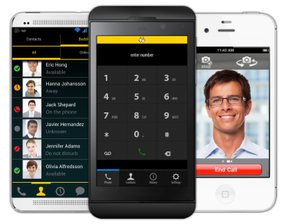
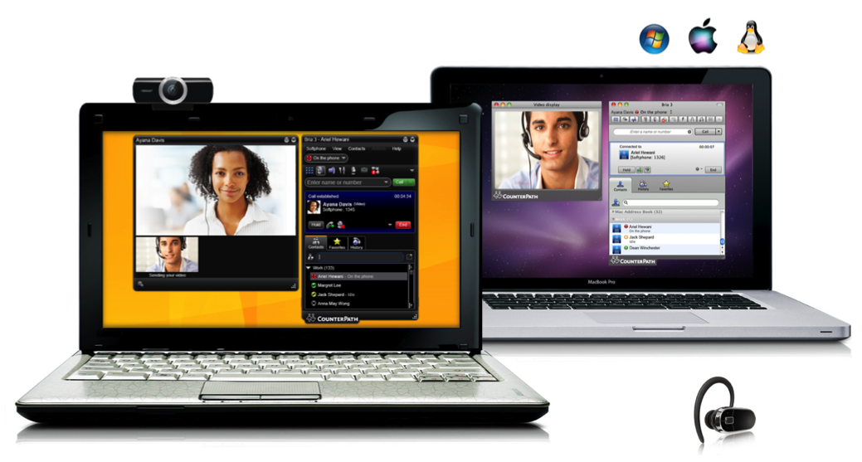
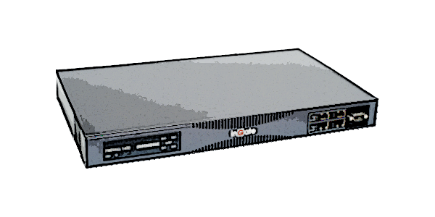
Enterprise Support for Remote Workers
Home user
Remote Worker
Hotel NAT
Home NAT
Traveling user
Internet
Remote SIP Connectivity module
802.11
Hotspot
SIP capable proxy-based firewall
Encrypted Media / Signal
Clear Media / Signal
VPN Tunnel
Codec Negotiation

Slide 6
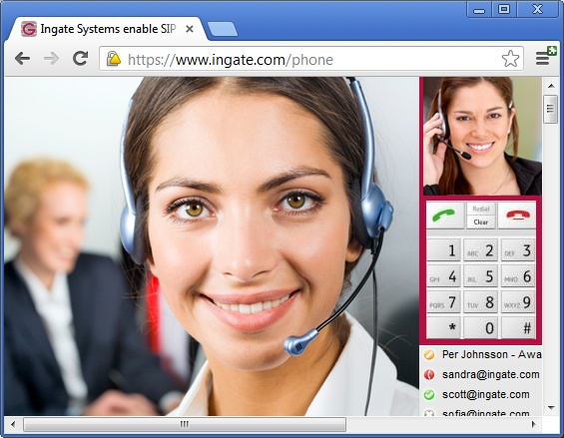
The WebRTC Browser as a Softphone
Having the PBX/UC Softphone available everywhere, on every device having a browser, without any plug-in and not just for plain voice phone calls, but potentially also for HiFi HD telepresence quality, is of course a dream.
The Ingate PBX Companion brings it to your PBX
The browser becomes your Softphone by surfing to a simple webpage
The Registrar can be in the PBX or in the Ingate (numbers can still be integrated)
Interfaces to the PBX via the SIP Trunk Interface if other not available.
All proven Ingate E-SBC functions included and is the interface to SIP
SIP E-SBC authentication and security available in addition to web page login
Simple Websocket interface to the SIP UA in the Ingate, as well as a SIP proxy interface for building a full SIP Client
Any Web Server can be used. There ís one in the Ingate, if preferred
E-SBC, SIP Trunking as well as Q-TURN QoS and Accounting

Slide 7
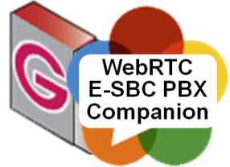





The WebRTC Browser as a Local Softphone
Browser becomes your Softphone by surfing to a webpage
Can be a full SIP Client in JS in the browser, or just “a page of JS” where the SIP UA is in the Ingate (recommended)
Any Web Server can be used. There will be one in the Ingate, if preferred.
The Registrar can be in the PBX or in the Ingate. “Numbers” can be integrated via the Ingate SIP Trunk page then.
SIP interface to the PBX via SIP Trunk Interface if other not available.
Authenticated WS or WSS interface to the PBX Companion, running Ingate’s RTCgate protocol and CONFgate protocol
The WS or WSS interface also includes the SIP protocol, Ingate’s full SIP Proxy interface as if accessed as via UPD, TCP or TLS
(Any)
Web Server
media
WS
SIP
HTTP
2
LAN
media
1

Slide 8

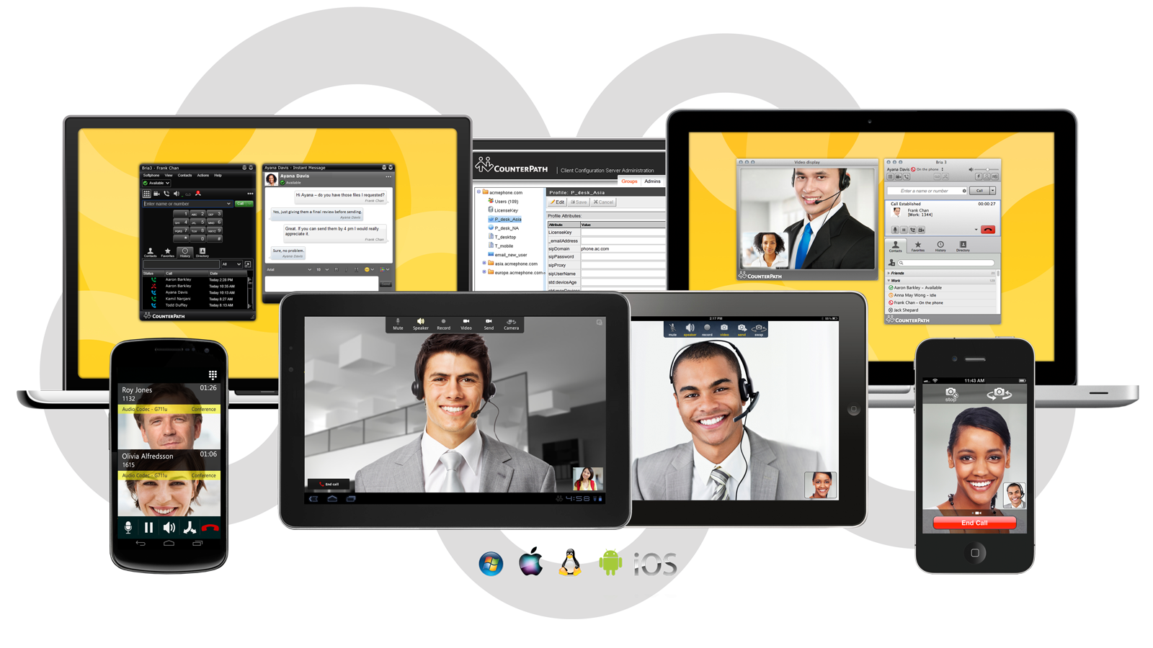





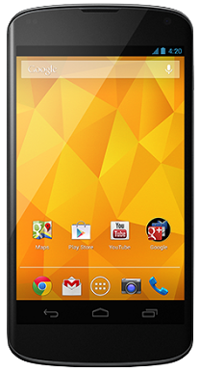
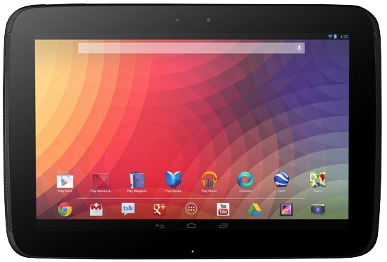
WebRTC Opportunity
Internet
PSTN

